Slide 1
Text and Audio Classification Enabled Diagnosis for Treatment Applications by Natural Language Processing (NLP) and Deep Learning (DL)
HAMEEM M MAHDI
National University, School of Technology and Engineering
Dissertation Chair: Dr. Fulton
Subject Matter Expert: Dr. Tsapara
Academic reader: Dr. Nabeel
Notes:
Good afternoon, doctors.
I am Hameem, a Senior Cloud Integrations Engineer at the Mayo Clinic, the world's number one hospital. I’ve been in the information technology field for over twenty years.
Today, I will discuss how "Text and Audio Classification Enabled Diagnosis for Treatment Applications by Natural Language Processing (NLP) and Deep Learning (DL)“ can help doctors diagnose patients better. My presentation shows how NLP and DL can understand patient text notes and voice recordings to improve medical treatment. This technology helps doctors work more efficiently and provide better care for patients.

Slide 2
INTRODUCTION
Healthcare settings face challenges in investigating textual and auditory data
Current diagnosis systems rely heavily on human interpretation
Paper-based procedures dominate data capture systems
Technology advancement offers potential solutions through NLP and DL
Data abundance in healthcare provides opportunity for improved diagnostics
Notes:
This study explores DL and NLP applications for disease classification using healthcare text and audio data to enhance medical diagnosis and treatment. (Lu et al., 2020; Heys et al., 2022) shared that the healthcare industry still largely depends on human analysis of medical records and outdated paper-based systems., (Stark et al., 2018) advise about the challenges for providers managing large data volumes. (Kobritz et al., 2023) research indicates that improved classification of medical data could lead to better diagnoses, reduced patient risk, (Al-Garadi et al., 2022) mentioned enhanced prediction of complications, and streamlined diagnoses through NLP. While Alan (1999) noted NLP's early potential was more promising than stable, Fagherazzi et al. (2021) emphasis on voice-based diagnosis and the rise of Electronic Health Records (EHR) demonstrate reliable progress in leveraging technology for improved healthcare outcomes.

Slide 3
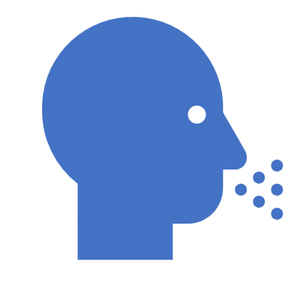
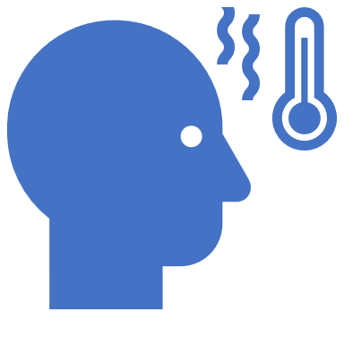
PROBLEM & PURPOSE STATEMENTS
Problem Statement:
Diagnosis and treatment planning involves human interpretation.
Mixed interpretation of medical records and speech complicates management.
Existing systems rely on paper-based procedures.
Paper-based systems negatively affect care decisions.
Purpose Statement:
Utilize advanced technologies to simplify healthcare diagnostics and treatment.
Apply NLP and DL to enhance diagnostic and treatment processes.
Notes:
The healthcare faces unsuccessful data use and manual interpretation causing diagnostic delays, errors, and rising costs that impact all stakeholders. (Stark et al., 2018; Heys et al., 2022) shared that the patients experience delayed treatment and poor outcomes while healthcare workers face burnout from data overload
Our automated tools will analyze medical text and audio, integrate data sources, and streamline diagnosis processes to deliver more accurate diagnoses, faster treatments, lower costs, and improved patient care with better resource utilization.

Slide 4
RESEARCH QUESTIONS & HYPOTHESES
RQ1: How effective is NLP in classifying patient symptoms from textual data?
H1o: NLP does not significantly improve text-based symptom classification
H1a: NLP significantly improves text-based symptom classification
RQ2: How effective is NLP in classifying patient symptoms from audio data?
H2o: NLP does not significantly improve audio-based symptom classification
H2a: NLP significantly improves audio-based symptom classification
Notes:
This study has two main questions.
First, can NLP technology correctly identify patient symptoms from written notes?
Second, can it identify symptoms from voice recordings?
For the first question, we think text analysis will be accurate enough to help doctors make better decisions under the alternative hypotheses (H1a), though we start by testing if it might not be good enough under the null hypotheses (H1o).
For the second question, we test if audio analysis might not be precise enough for doctors under the null hypotheses (H2o). We test if audio analysis will be precise enough for doctors under the alternative hypotheses (H1a).
This research is vital because it could help doctors diagnose patients faster and more accurately by using Artificial Intelligence (AI) to process information from both written notes and voice recordings.

Slide 5
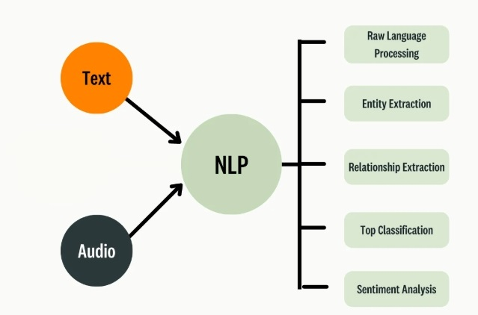
CONCEPTUAL FRAMEWORK
NLP and DL Integration Framework
Disease Classification Process
Text and Audio Analysis Components
Healthcare Implementation Model
Notes:
A constructive research design was chosen because it aligns with the study's goal of developing practical NLP and DL models for healthcare diagnostics.
Special AI computing like Convolutional Neural Network (CNN) and Bidirectional Encoder Representations from Transformers (BERT) analyze medical information by finding important patterns in words and sounds. The system processes patient data by extracting key details that help identify specific diseases. For text, the computer learns word meanings, while for audio, it analyzes sound patterns. When used in hospitals, this technology helps doctors spot diseases earlier by finding hidden symptoms in patient records. This leads to faster, more accurate diagnoses and better patient care.

Slide 6
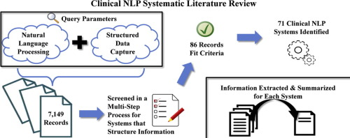
Notes:
Doctors make mistakes in about 5% of patient visits because they don't have good technology to help them. Current systems are slow and make it hard to understand patient information. If we use standard ways to diagnose patients and add computer technology that can read text and understand voice recordings, doctors can make fewer mistakes. This new technology helps by quickly analyzing patient information, leading to better healthcare for everyone.

Slide 7
REVIEW OF THE LITERATURE
Major studies/sections:
Poor diagnosis prevalence (5% error rate in adult primary care)
Impact of technological limitations on healthcare
Need for standardization of diagnostic processes
Integration of NLP and DL in healthcare settings
Notes:
About 5% of doctor visits have wrong diagnoses. This happens because current technology is not good enough to help doctors analyze patient information quickly and correctly. Doctors find it hard to manage all the written notes and voice recordings from patients. We need standard ways for all doctors to diagnose problems. New computer technology called NLP and DL can help by reading patient notes and listening to recordings automatically. This technology helps doctors identify diseases more accurately and create better treatment plans, making healthcare better for everyone.

Slide 8
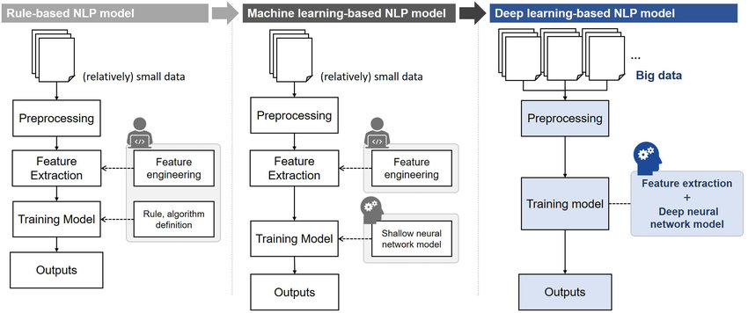
RESEARCH METHODOLOGY & DESIGN
Notes:
We analyze both written notes and voice recordings from patients using special AI algorithms. We chose this method because it can solve real problems in healthcare and can be tested with specific numbers to prove it works. The study helps doctors by automatically processing patient information that would take too long to review manually. The computer system cleans up the text by removing unnecessary words and symbols, then uses AI to find patterns that help identify diseases. They measure how well the system works by checking if it correctly identifies patients' conditions. This technology could help doctors make fewer mistakes and provide better treatment.

Slide 9
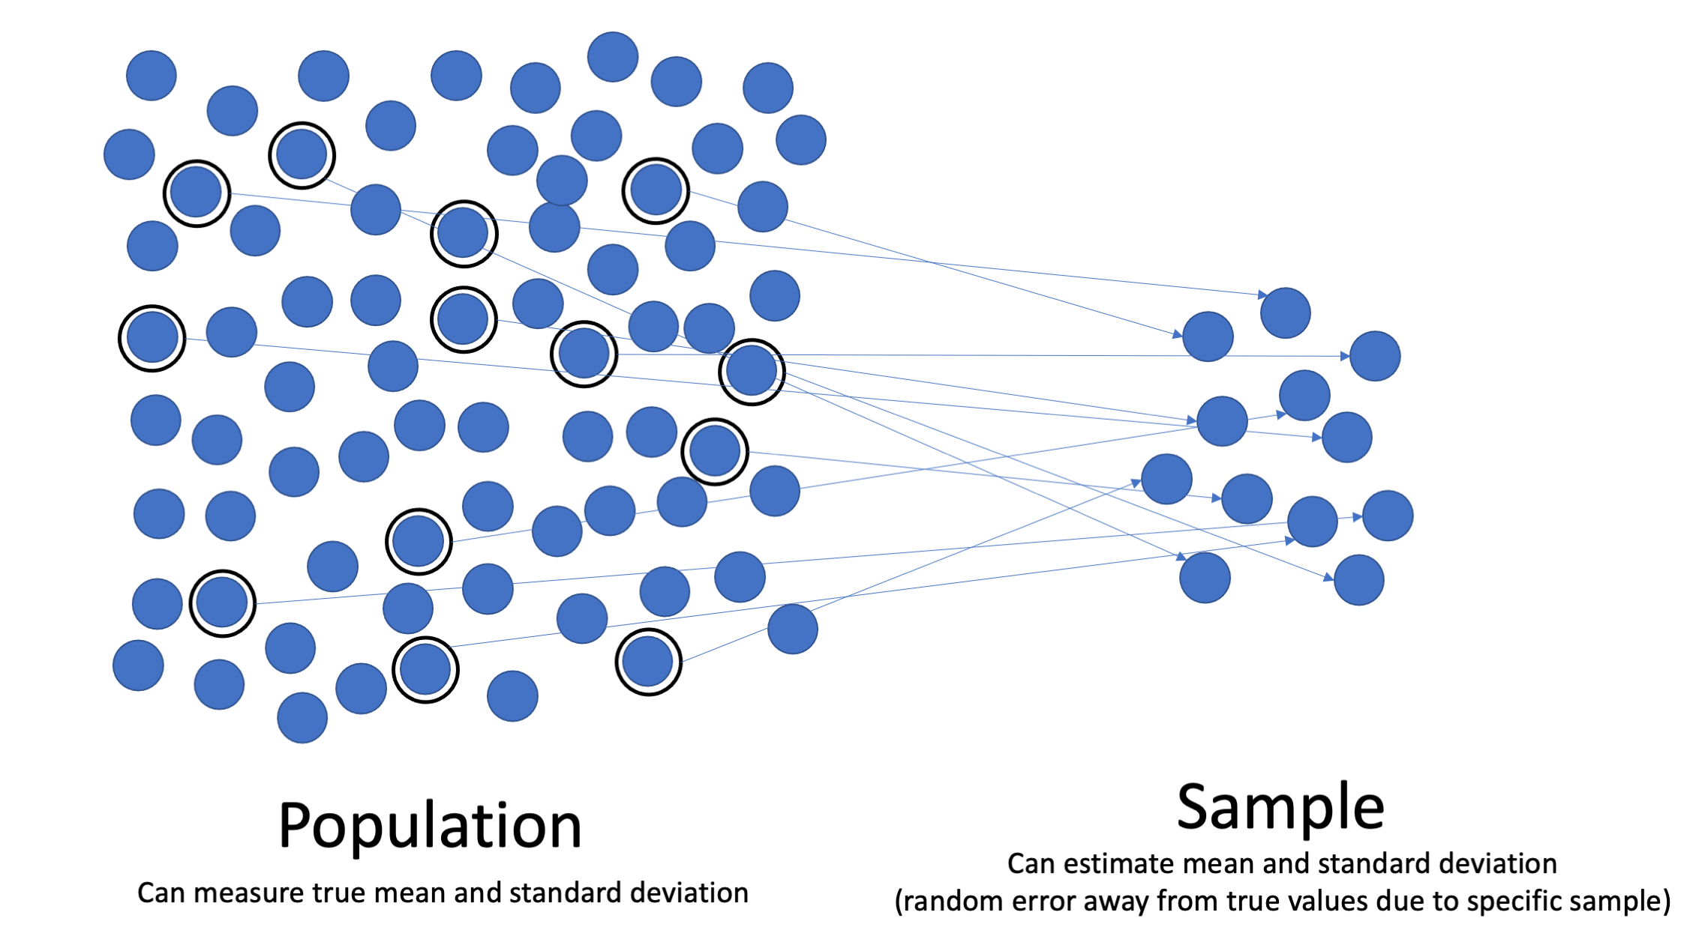
POPULATION & SAMPLE
Population Description:
Adult patients (18-65) approximately 7,221 with chronic diseases in primary care.
Appropriateness of the Population:
Relevant for studying diagnostic accuracy in chronic disease management.
Sample Description:
370 patients selected via stratified random sampling.
Inclusion Criteria:
Patients aged 18-65 with chronic diseases and 3+ follow-up visits.
Sampling Guidelines:
Randomly selected within strata (age, gender, disease type).
Power Analysis:
Sample of 370 ensures 0.80 power at 0.05 significance.
Recruitment Efforts:
Patients recruited via providers, flyers, and consent forms.
Notes:
This study looked at sick patients from a hospital in Washington, DC. There were about 7,221 patients of different ages - young, middle-aged, and older people. We selected 370 patient records public dataset from Kaggle. The Kaggle dataset was selected because it contained structured and labeled audio and text data. The data is public visible to everyone, which ensured no Personally Identifiable Information (PII) was included. These records included both written notes and voice recordings. We chose patients randomly to avoid bias and used a special calculator to make sure 370 was enough patients to get reliable results. The calculator showed this number would give answers that are 95% reliable with only a 5% chance of error. This research helps doctors better understand patient information to improve diagnosis.

Slide 10
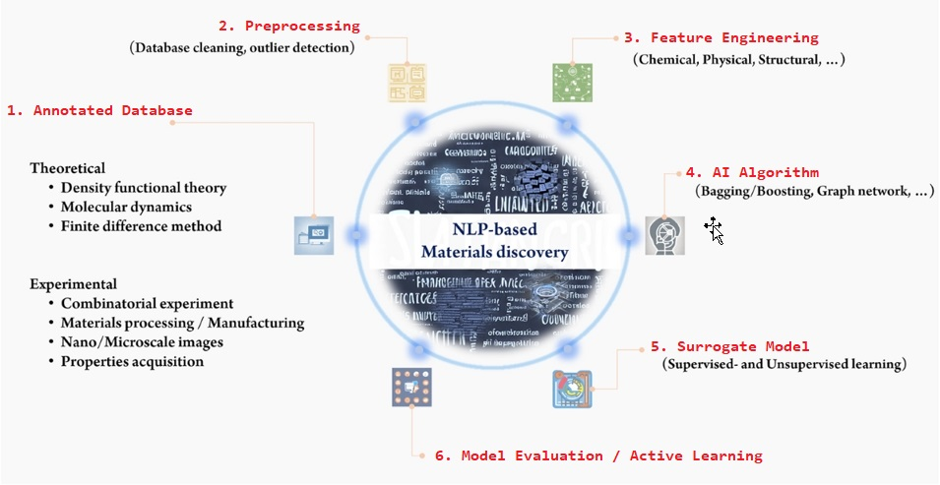
MATERIALS & INSTRUMENTATION
Notes:
This study used two AI computing tools to help doctors diagnose patients better. The first is NLP Toolkit reads patient notes the second tool DL Audio Classifier analyzes patient voice recordings.

Slide 11
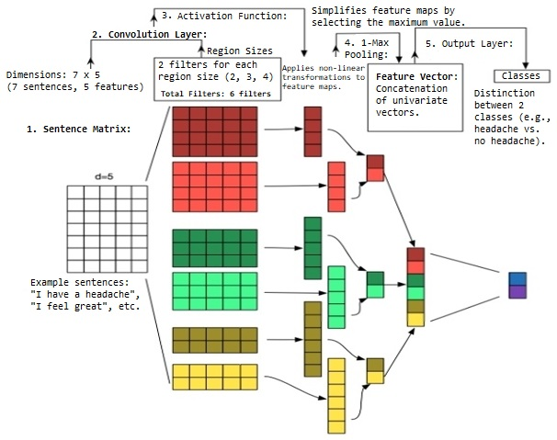
OPERATIONAL DEFINITIONS OF VARIABLES
Notes:
This study looks at how AI computing tools can help doctors make correct diagnoses. It uses two main types of information: written notes (Textual Data) and voice recordings (Audio Data) from patients to predict diseases. The study measures how accurate these predictions are compared to what expert doctors diagnose (Diagnostic Accuracy). The researchers also consider patient information like age and gender, and where patients received care (hospital or clinic). Accuracy is measured as a percentage (0-100%) showing how often the NLP and DL correctly identifies diseases. The study combines results from both text and audio analysis to get a complete picture of how well these AI computing work.

Slide 12
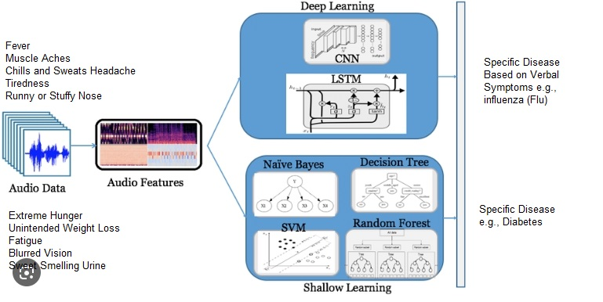
STUDY PROCEDURES
Systematic literature review process:
Database selection
Search key identification
Data collection
Analysis implementation
Results validation
Notes:
The first step in this research involved obtaining Institutional Review Board (IRB) approval to guarantee adherence to ethical standards in data usage. This included ensuring compliance with data protection regulations, such as HIPAA, to protect patient privacy. Then we worked with hospitals to collect patient records and voice recordings from the last five years. We cleaned this information by removing unnecessary words from text and improving audio quality. Next, we used two special AI computing: one is NLP to read patient notes, and another is DL to analyze voice recordings. We measured how well these computing identified diseases by checking accuracy, precision, recall, and F1-scores. Finally, we compared the machine learning algorithms results with diagnoses from real doctors to see if the technology worked correctly.

Slide 13
DATA ANALYSIS
Data Selection And Collection
Preprocess the Data
Two Classes
Multiclass
Create Word Embeddings
LSTM
Word2vec
BERT
Bi-LSTM
Test and Predict
Train the model
CNN
Notes:
Data Analysis Steps
The study tests two main ideas:
Text Analysis: Checks if text analysis of patient symptoms is accurate enough for healthcare decisions. It uses binary classification, with metrics like precision, recall, F1-score, ROC-AUC, and confusion matrix. Assumptions like random sampling and normal errors will be tested. Python 3.8 and scikit-learn will be used. Logistic Regression is chosen because it fits binary outcomes, large datasets, and linear relationships.
Audio Analysis: Checks if audio analysis of symptoms is accurate enough for healthcare decisions. It uses multi-class classification, with metrics like accuracy, cross-validation, and reliability. Assumptions like balanced data and good quality will be checked. PyTorch, Keras, and Librosa will be used. Convolutional Neural Networks (CNNs) are chosen because they handle complex patterns, large datasets, and non-linear relationships.
Testing Assumptions
Tests like Shapiro-Wilk, Q-Q plots, and histograms will check for normal data. Durbin-Watson and residual plots will check for independence.
Additional Tests
10-fold cross-validation and hold-out validation will be used. Performance will be measured using Area Under the Curve (AUC), Mean Square Error (MSE), and Root Mean Square Error (RMSE).

Slide 14
Research Questions
RQ1: What is the effectiveness of the NLP algorithm in classifying patient symptoms from the text data at the population level?
RQ2: How practical is DL in classifying patient symptoms from audio data?
Notes:
In this study, we explored the potential of DL in diagnosing and treating patients. Specifically, we address two key research questions: RQ1 investigates the effectiveness of NLP algorithms in classifying patient symptoms from textual data at the population level, while RQ2 examines the usefulness of using NLP for classifying patient symptoms from audio data.

Slide 15
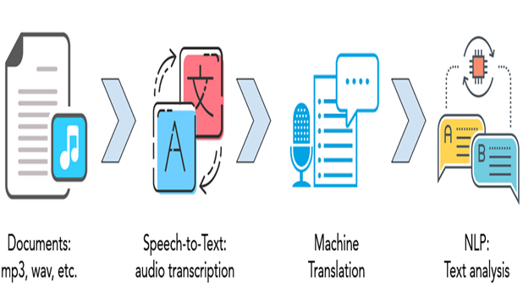
Exploratory Analysis Findings
Data Characteristics
Data Quality Assessment
Feature Engineering:
Notes:
Data Characteristics:
The dataset comprised 5,385 training observations (text and audio) and 385 test observations.
Key attributes included audio quality, speaker identification, and textual phrases.
Data Quality Assessment:
Audio quality ratings ranged from 2.5 to 5.0, with most ratings clustering around 3.75.
Textual data showed a balanced distribution of symptoms, essential for effective classification.
Feature Engineering:
Techniques such as tokenization, stop word removal, and feature interaction were employed to enhance model performance.
Mel-Frequency Cepstral Coefficients (MFCC) (ميل فركونسي كرستل كوفشنت) were used for audio feature extraction.

Slide 16
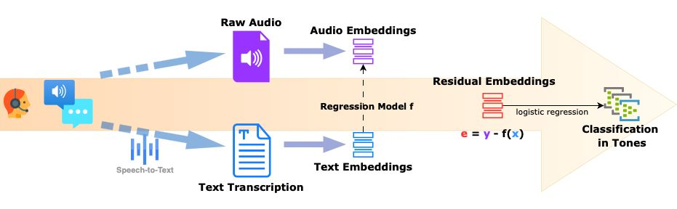
Detailed Results from Experiments (Text Classification)
Model Performance
Evaluation Metrics
Interpretation of Results
Notes:
Text Model Results
SVM and Logistic Regression had 100% accuracy in text classification. Random Forest and XGBoost also performed very well (around 99.5% accuracy).
Evaluation Metrics
Precision and Recall were important to check model performance, especially with uneven data. The F1-score balanced these metrics, which is key for healthcare.
What This Means
High accuracy shows the models classify symptoms well, but Precision and Recall ensure fewer mistakes (false positives and negatives).

Slide 17
Detailed Results from Experiments (Audio Classification)
Audio Classification Performance
Model Robustness
Hyperparameter tuning
Interpretation of Results:
Notes:
Audio Classification Results
The XGBoost model had the best accuracy (98.27%) for audio data. CNN and RNN models also worked well, showing they can find complex patterns in audio.
Model Reliability
Cross-validation was used to make sure the models were reliable and not overfitting. Hyperparameters (like learning rates) were tuned to improve performance.
What This Means
Accurate audio symptom classification helps healthcare providers make better decisions, which can improve patient care.

Slide 18
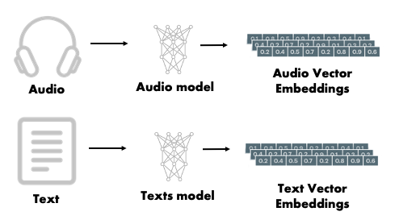
Embeddings and Their Impact
Embeddings Utilized
Impact on Model Performance
Notes:
Embeddings Used
For text, BERT embeddings were used to understand context and improve accuracy. For audio, I-vectors and x-vectors helped classify sounds effectively.
Impact on Model
Embeddings made the models better at handling new data, increasing accuracy and reliability. They also helped the models understand the data more deeply, which is key for accurate symptom classification.

Slide 19
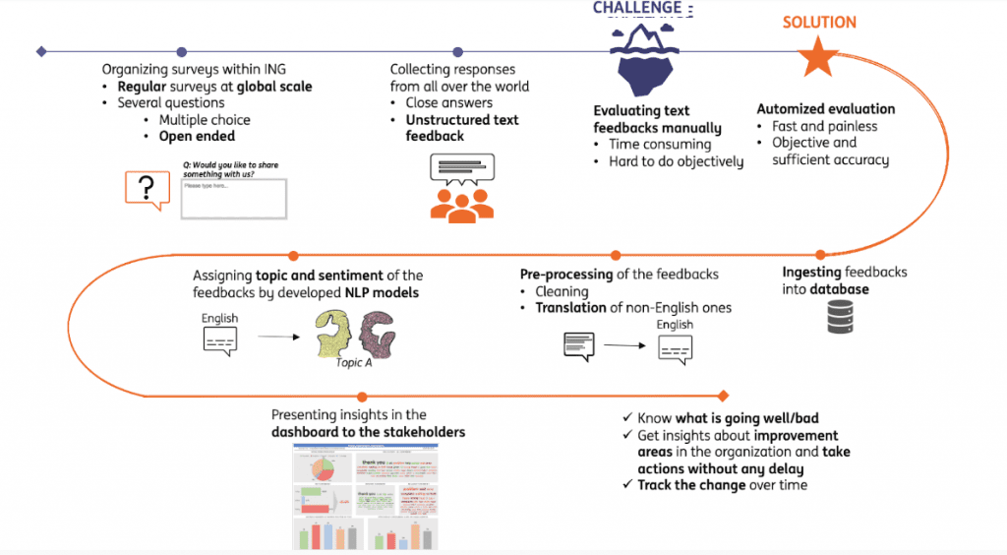
Model Development and Performance
Notes:
Various machine learning algorithms were evaluated, including Naive Bayes, Support Vector Machines (SVM), Decision Trees, and Random Forests, among others. Support Vector Machines (SVM) and Logistic Regression achieved perfect accuracy (100%) for text classification, while XGBoost demonstrated high levels of accuracy in audio classification 98.27% (0.9827%).
The CRISP-DM framework was employed for systematic model deployment, which facilitated real-time analysis and effective integration into clinical workflows.

Slide 20
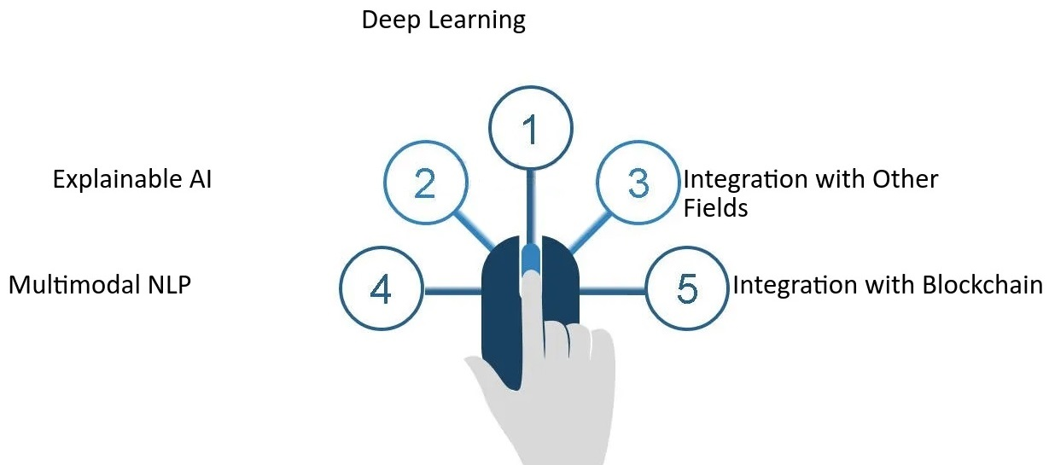
Conclusion and Future Directions
Key Findings
Future Research Directions
Notes:
Key findings: The study showed that NLP and DL methods work well for classifying patient symptoms from text and audio. High accuracy suggests these technologies can improve healthcare diagnosis.
Future Research: Explore combining text, audio, and other data (like images) for better diagnostics. Improve models to make them easier to understand and address ethical issues in AI healthcare.

Slide 21
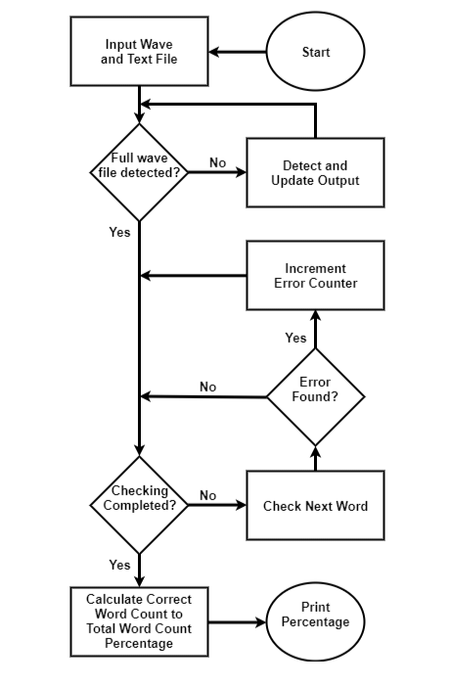
RESULTS Interpretation
Audio Classification Accuracy
XGBoost: 0.9827 (98.27%)
Random Forest: 0.9737 (97.37%)
Decision Tree: 0.9505 (95.05%)
Neural Networks (CNN): 0.9055 (90.55%)
Neural Networks (RNN): 0.8800 (88.00%)
Logistic Regression: 0.8785 (87.85%)
Support Vector Machines (SVM): 0.8725 (87.25%)
Naive Bayes: 0.8725 (87.25%)
Precision, Recall, and F1-Score:
XGBoost: Precision = 0.88, Recall = 0.84, F1-Score = 0.86
Random Forest : Precision = 0.86, Recall = 0.83, F1-Score = 0.85
Confusion Matrix:
XGBoost and Random Forest achieved the highest accuracy, with minimal misclassification.
Notes:
The study evaluated multiple ML algorithms for audio classification, with the results. The study shows the precision, recall, and F1 scores for only two classifiers: Naive Bayes:
Precision: 0.6
Recall: 0.6
F1-Score: 0.3
True positive rate: 61.28%
False negative rate: 38.73%
SVMs:
Precision: 0.7
Recall: 0.7
F1-Score: 0.3
True positive rate: 79.66%
False negative rate: 20.34%.
The audio classification study shows that while these two classifiers have produced better results in classifying medical ailment symptoms, they are "too far from achieving highly accurate performance." The research suggests that proper mechanisms need to be identified to improve classifier performance.
XGBoost and Random Forest were identified as the most effective algorithms for audio classification, achieving the highest accuracy with minimal misclassification according to the confusion matrix analysis. The study shows that "3-Fold Cross-Validation" was used in model evaluation, with an average accuracy across all folds of 0.87666666666666.

Slide 22
RESULTS Interpretation
Text Classification Accuracy
Support Vector Machines (SVM): 1.0 (100%)
Logistic Regression: 1.0 (100%)
Random Forest: 0.9954988747186797 (99.55%)
Decision Tree: 0.9954988747186797 (99.55%)
XGBoost: 0.994748687171793 (99.47%)
Naive Bayes: 0.9714928732183046 (97.15%)
Neural Networks (CNN): 0.9497374296188354 (94.97%)
Neural Networks (RNN): 0.9497374296188354 (94.97%)
Precision, Recall, and F1-Score:
SVM : Precision = 1.00, Recall = 1.00, F1-Score = 1.00
Logistic Regression: Precision = 0.86, Recall = 0.83, F1-Score = 0.85
Confusion Matrix:
SVM and Logistic Regression achieved perfect classification with no false positives or negatives.
Notes:
The classification reports for the best performing models showed excellent results:
For the highest performing models (SVM and Logistic Regression), the study showing the classification reports showed precision, recall, and F1-score had an accuracy of 100%.
The macro average and weighted average across all categories showed an F1-score of 0.97, indicating similar accuracy in diagnosing both common and rare conditions.
For specific symptoms like Acne, Cough, Blurry vision, and feeling cold, the models achieved precision, recall, and F1-scores approaching 1.00, revealing almost perfect identification and prediction of these conditions.
For some phrases like "Heart hurts," "Muscle pain," and "sports injury," precision and recall ratios were somewhat lower, around 0.88 to 0.96.
Model Performance Analysis
The text classification study utilized 3-fold cross-validation, with the average accuracy across all folds being 0.87666666666666. The validation accuracy score was 99.5%, while the training accuracy score was 99.8%, indicating minimal overfitting.
The study notes that "Random Forest and Decision Tree demonstrated that the datasets adopted fit for purpose as they achieved higher accuracy," highlighting that these classifiers performed well and would enhance the applications' implementation approaches. The study concludes that these text classification models are highly effective for classifying symptoms from medical data. They could significantly improve medical diagnosis and enhance effectiveness in handling patients' diseases.

Slide 23
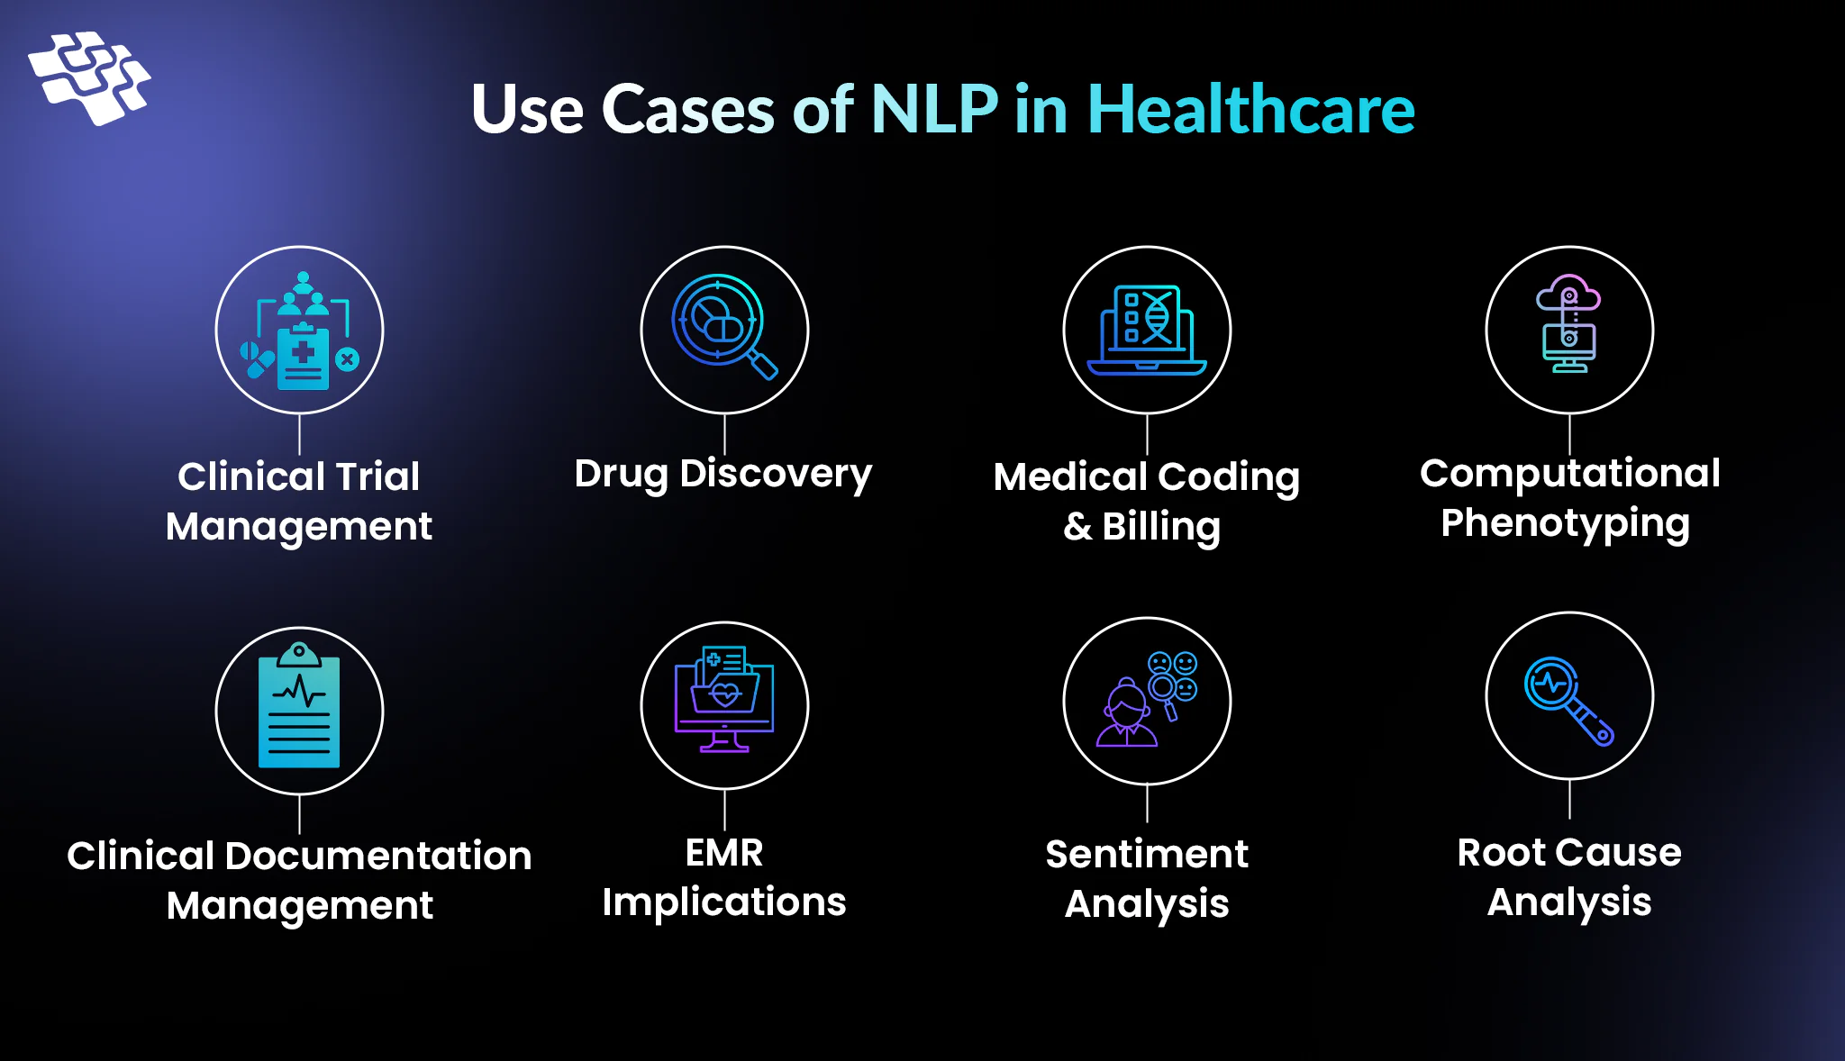
IMPLICATIONS
Notes:
The study showed these programs are accurate enough to be useful in hospitals and clinics. Some things affected the results, like the quality of patient data used to train the computer and differences in how people describe their symptoms. The findings match what other researchers have found - that these AI tools can help with medical diagnosis. However, there were some differences when compared to other studies, possibly because of different research methods or patient groups. More research is still needed to better understand how these AI tools can help doctors in different situations. Overall, hospitals should consider using these tools to improve patient care.

Slide 24
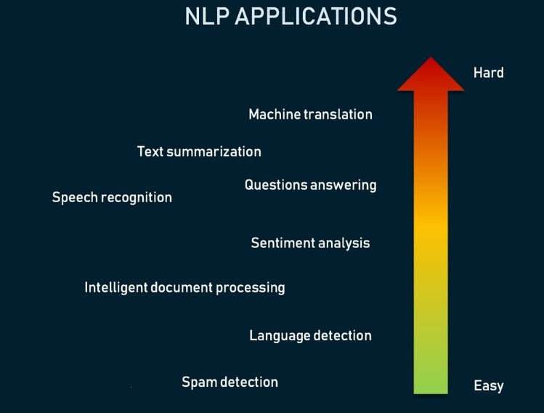
RECOMMENDATIONS (PRACTICAL APPLICATION)
Notes:
This study recommends three main actions based on its findings:
First, hospitals should use AI computing that can read patient notes to help doctors make diagnoses. These programs were 85% accurate in identifying symptoms.
Second, doctors and nurses need regular training to feel comfortable using these new AI powered tools. When healthcare workers understand the technology, they can use it better.
Third, hospitals should collect both written notes and voice recordings from patients because using both types of information leads to more accurate diagnoses. However, more research is needed before these tools can be used everywhere.
These recommendations can help improve healthcare by making diagnoses faster and more accurate, which means better treatment for patients.

Slide 25
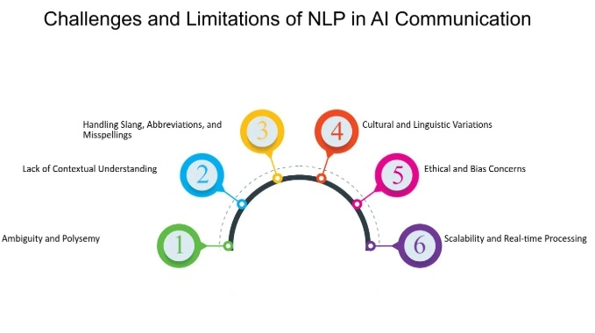
LIMITATIONS
Identified limitations:
Current data capture system limitations
Human interpretation variations
Technological constraints
Implementation challenges
Notes:
This study has some limitations:
To handle data quality issues… strict rules and cleaning steps were used.
To make the results more widely applicable… data from different sources were included.
While the study used a large amount of data… some groups might not be fully represented.
Finaly, technology limits were managed by using cloud tools and updated software. Possible biases were reduced with automated methods and cross-checking. Time limits prevented long-term analysis, which is recommended for future work. Ethical concerns about patient data were addressed by following IRB guidelines.

Slide 26
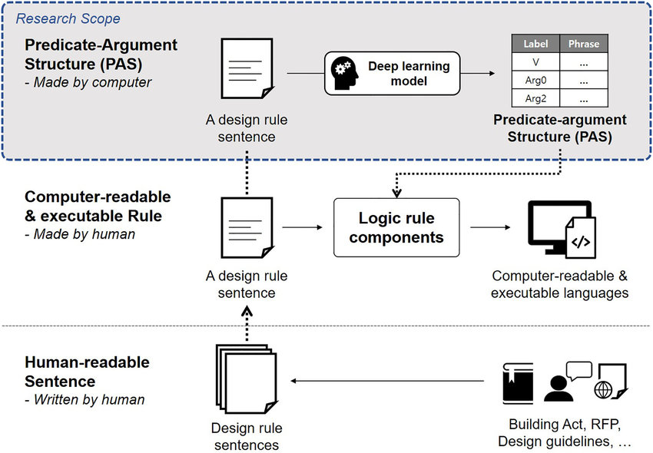
RECOMMENDATIONS (FUTURE RESEARCH)
Recommendation 1: Explore Diverse Populations.
Recommendation 2: Longitudinal Studies.
Recommendation 3: Integrate Advanced Machine Learning Techniques.
Notes:
For future research on AI powered tools that analyze patient textual data, and audio data the study recommend three important steps.
First, test these AI powered tools with many different types of patients (like different ages, backgrounds, and illnesses) to make sure they work well for everyone.
Second, study how these AI powered tools help patients over many months or years, not just present time. This will show if they really improve healthcare in the long run.
Third, try using newer and more advanced AI algorithms to make these tools even more accurate.
These recommendations will help make AI powered tools better at helping doctors diagnose patients correctly, which can improve healthcare for people who speak different languages or come from different cultures.
We envision the NLP and DL models can be integrated into Electronic Health Record (EHR) systems to assist healthcare providers in analyzing patient symptoms from text and audio data.
This would streamline the diagnostic process, reduce delays, and improve treatment accuracy. Additionally, the models can be used in telemedicine platforms to enhance remote patient monitoring and diagnosis.

Slide 27
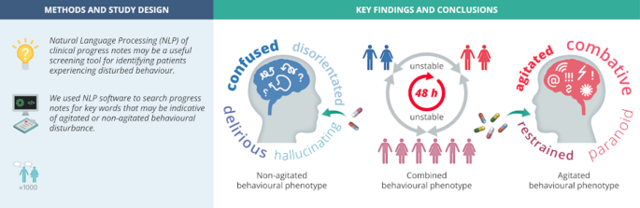
CONCLUSIONS
Overarching Conclusions
Connection to Framework and Literature
Main Message and Recommendations
Notes:
This study found that AI powered tools analyze patient textual data with NLP and audio data with DL can greatly improve how doctors diagnose health problems. The research shows these tools give fast and accurate results when identifying patient symptoms. This matches what other researchers have discovered about using AI in healthcare. The most important message is that these AI powered tools for patent diagnoses can make big improvements in how doctors diagnose patients. For the future, researchers should test these tools with many different types of patients, study how well they work over longer periods, and use newer built-in AI powered tools methods to make them even better as API (Application Programming Interface) is a set of rules and protocols that allows different software applications to communicate and exchange data. This research helps show that these technology tools should be used more widely in hospitals and clinics to improve patient care.

Slide 28
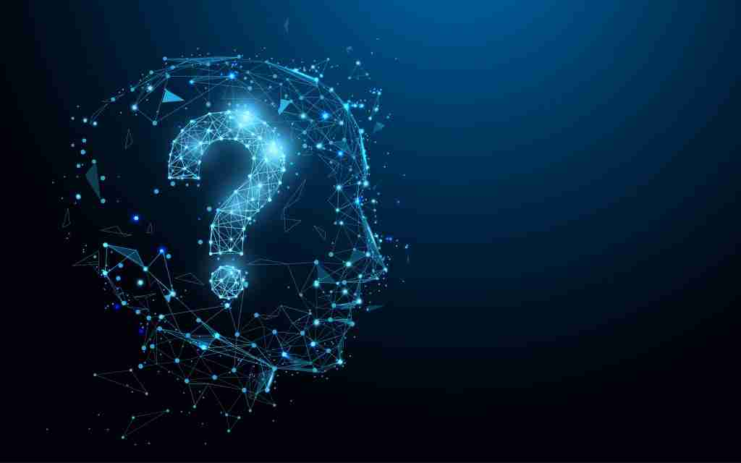
THANK YOU
Notes:
Thank you for your attention. Are there any questions?

Slide 29
Lu et al. (2020), which discusses the complexity of diagnosing and treating diseases using textual and auditory data
Heys et al. (2022), which critiques current data capture systems and their impact on care decisions
Kim & Lee (2021), presenting estimates on medical deaths due to errors in the U.S. healthcare system
Leary et al. (2021), emphasizing the need for proper diagnoses to ensure effective healthcare systems
Newman-Toker et al. (2020), analyzing the impact of diagnostic errors on patient mortality
Alturaiki et al. (2023), contributing to the conversation around health statistics and diagnostic reliability
REFERENCES

